Slide 1
Curves and Surfaces Advanced Scripting & Parametrics

Slide 2
Curves and Surfaces Design Programming 2
Agenda
A word on final projects
Back to Transformation Matrices
Python in grasshopper
Curves
General theory of curves
Bezier and NURBS curves
Rhino curve functionality
In 2 weeks Surfaces
General theory of surfaces
Bezier and NURBS surfaces
Rhino curve functionality
Surface curvature

Slide 3
Final Projects
Have an initial proposal ready when we get back Feb 24

Slide 4
Curves – tying it all together
Our transform function
Generalized
Some complicated
function_{x}(x_{old}, y_{old}, z_{old})
Some complicated
function_{y}(x_{old}, y_{old}, z_{old})
Some complicated
function_{z}(x_{old}, y_{old}, z_{old})
Now: Curves
Fx(t)
Fy(t)
Fz(t)

Slide 5
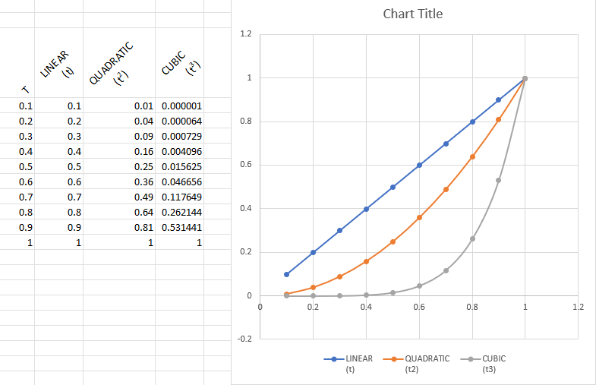
Y = aX + b
Y = aX^{3 + b}X² + cX + d

Slide 6
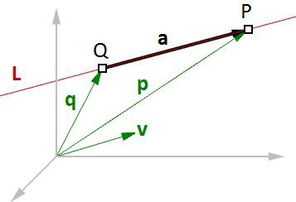
Vector equation of line – 2 point curve
The vector line equation is used in 3D modeling applications and computer graphics.
P₁
P₀
If we know the direction of a line and a point on that line, then we can find any other point on the line using vectors, as in the following:
L = line
v = <a, b, c> line direction unit vector Q = (x0, y0, z0) line position point
P = (x, y, z) any point on the line
P = Q + t * v
Given a point Q and a direction v on a line, any point P on that line can be calculated using the vector equation of a line C = Q + t * v where t is a number.
C_{t} = P₀ + t * (P₁ – P₀)
t=0: P₀
t=1: P₁
t=0.5: (P₁ + P₀) #midpoint
2

Slide 7
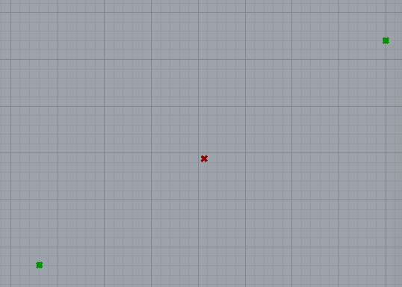
Curves as a blending function
Given points p1, p2, and t = [0…1]
C_{t} = 1*P₀ + t * (P₁ – P₀)
C_{t} = (1-t) * P₀ + t * P₁
OR
C_{t} = (1-t)*P0 + t*P1
C_{t=0} = (1)*P0 + 0*P1
C_{t=1} = (1-t)*P0 + t*P1
C_{t=0.5} = (1-0.5)*P0 + 0.5*P1
= ( (1 – t)*p0_{x} + t*p1_{x} ,
(1 – t)*p0_{y} + t*p1_{y} ,
(1 – t)*p0_{z} + t*p1_{z} )
t=0: P₀
t=1: P₁
t=0.5: (P₁ + P₀) #midpoint
2

Slide 8
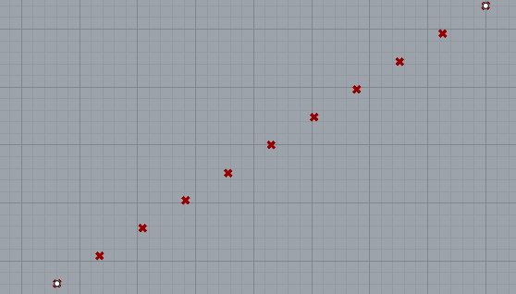
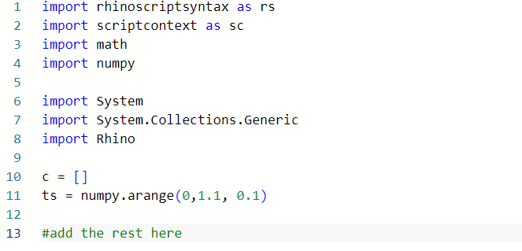
Try it yourself – a list of points

Slide 9
Curves as a blending function: 2 points
1-t
t
p1
(1-t)*p1 + t*p2
p2
Curves as a blending function: 3 points!
p2
p₂₃=(1-t)*p₂ + t*p₃
p₁₂=(1-t)*p₁+ t*p₂
p = (1-t)*p₁₂+ t*p₂₃
p = (1-t)*((1-t)*p₁+ t*p₂ )
+ t* ((1-t)*p₂ + t*p₃)
p = (1-t)²*p₁+
2t(1-t)*p₂+
t²*p₃
p1
p3

Slide 10
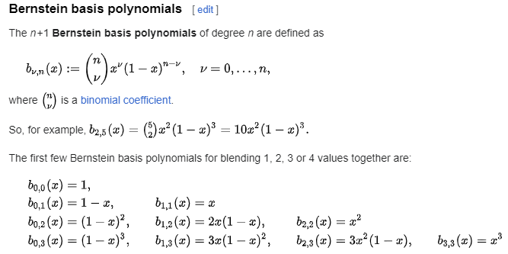
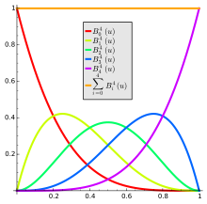
Bernstein Polynomials

Slide 11
A LINEAR BEZIER Curve
Order = 1 = #points(2) - 1
1-t
t
p1
(1-t)*p1 + t*p2
p2
A QUADRATIC BEZIER Curve
Order = 2 = #points(3) - 1
p2
p = (1-t)²*p₁+
2t(1-t)*p₂
t²*p₃
p1
p3
A CUBIC BEZIER Curve
Order = 3 = #points(4) - 1
p2
p3
p1
p4

Slide 12
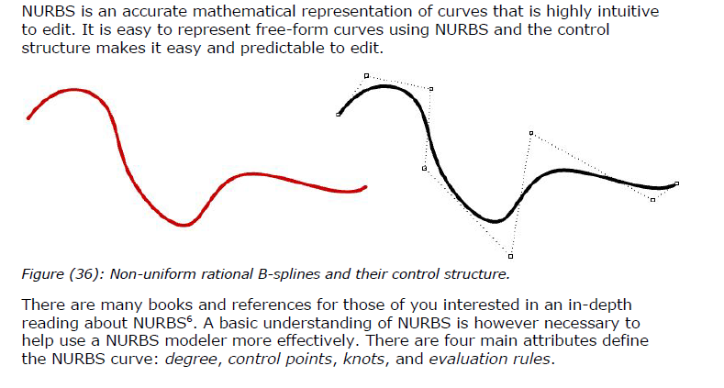
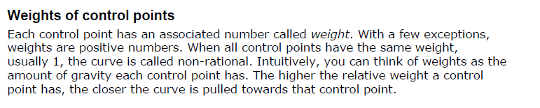
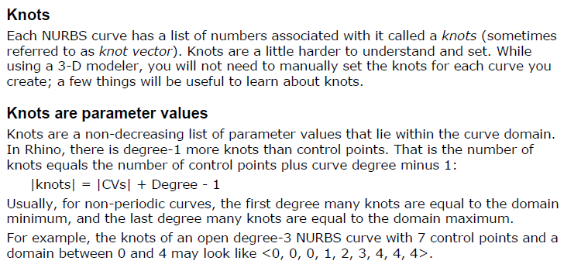
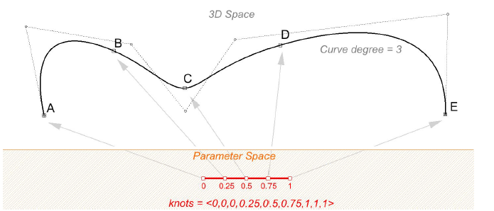
NURBS Curves

Slide 13
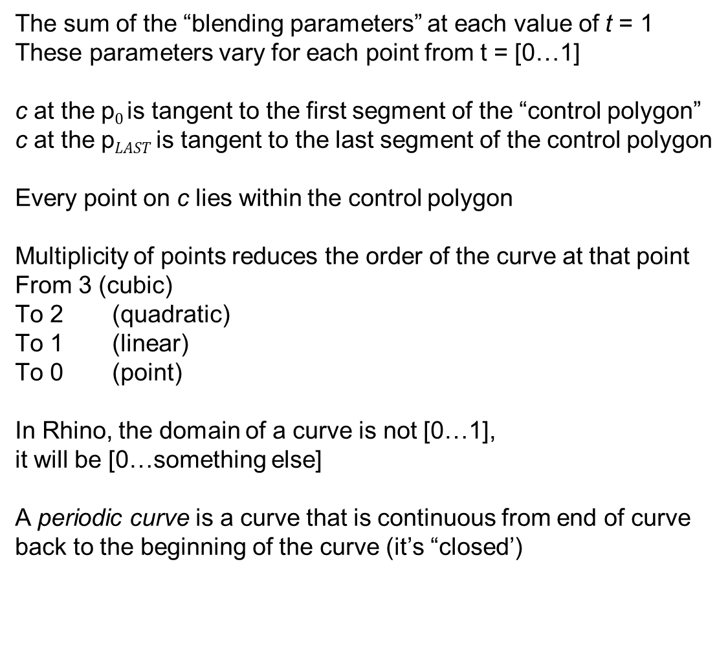
Properties of Bezier / NURBS Curves
The sum of the “blending parameters” at each value of t = 1
These parameters vary for each point from t = [0…1]
c at the p$0$is tangent to the first segment of the “control polygon”
c at the p$LAST$is tangent to the last segment of the control polygon
Every point on c lies within the control polygon
Multiplicity of points reduces the order of the curve at that point
From 3 (cubic)
To 2 (quadratic)
To 1 (linear)
To 0 (point)
In Rhino, the domain of a curve is not [0…1], it will be [0…something else]
A periodic curve is a curve that is continuous from end of curve back to the beginning of the curve (it’s “closed’)

Slide 14
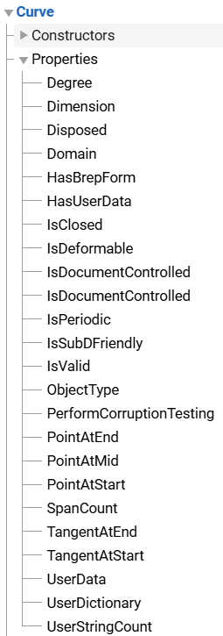
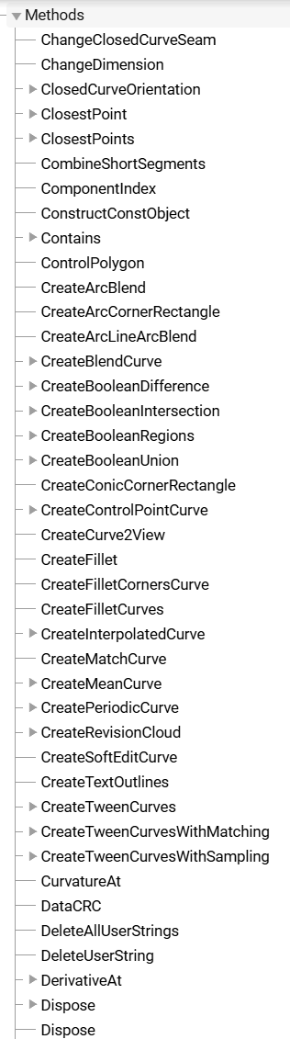
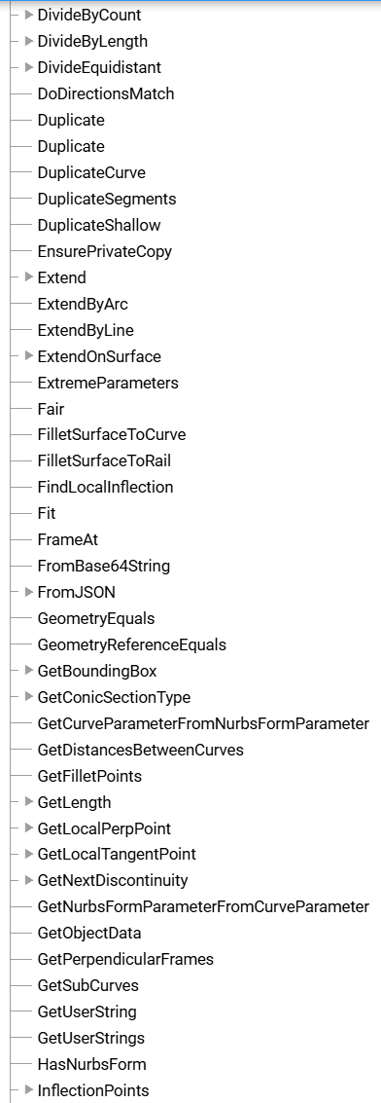
Curve API

Slide 15
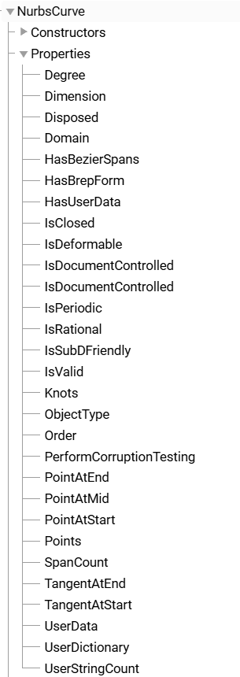
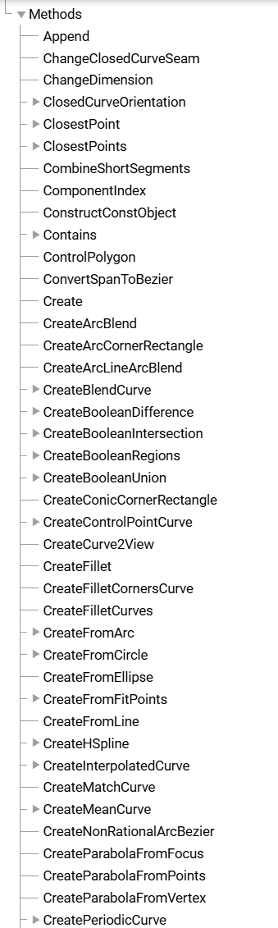
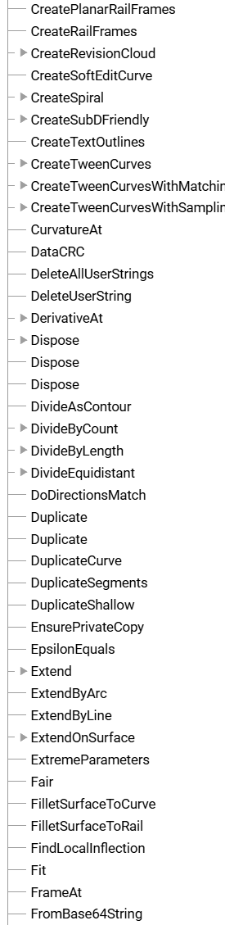
NurbsCurve API

Slide 16
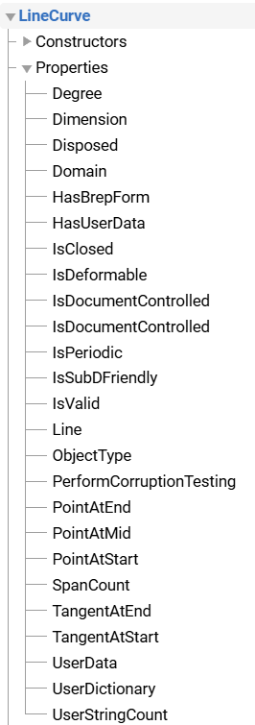
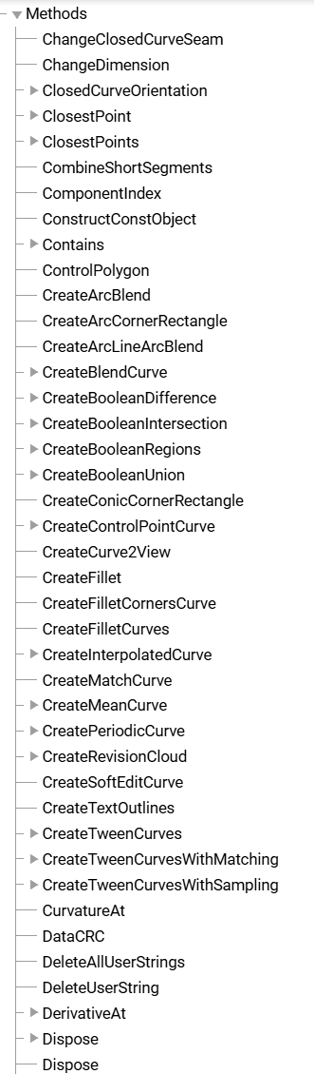
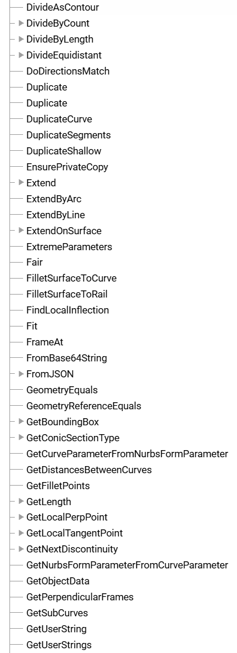
LineCurve API

Slide 17
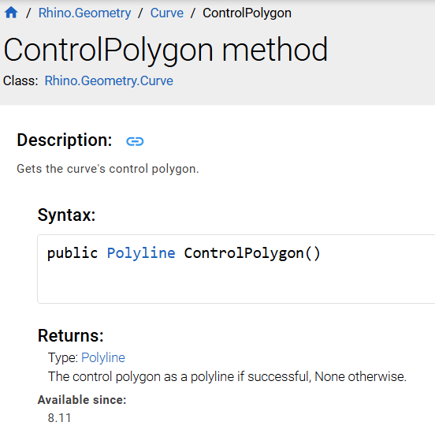
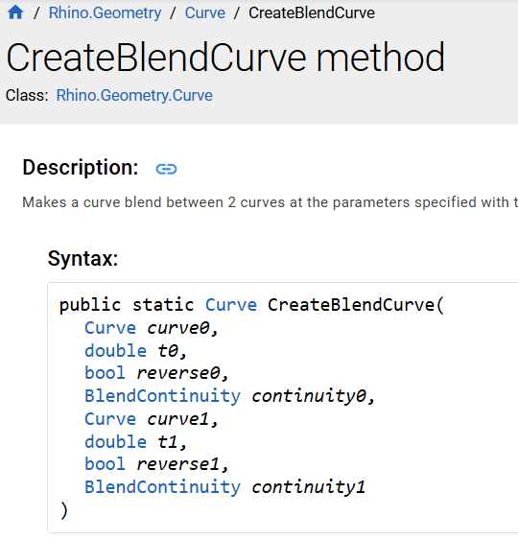
Classes - redoux
Recall:
Class: the category of instances
Instance: a specific example of the category
Properties
Properties tend to be of the instance, and are data contained by the instance. They are accessed as variables:
myThing.name
crv.Degree
Methods
Methods are functions of the class or the instance. There are two types:
Instance methods – send and receive messages to the instance.
crv.ControlPolygon() #gets the curve polygon
Class (“Static”) methods: send and receive messages from the class

Slide 18
Exercise: create a script that accesses curve instance and class functions

Slide 19
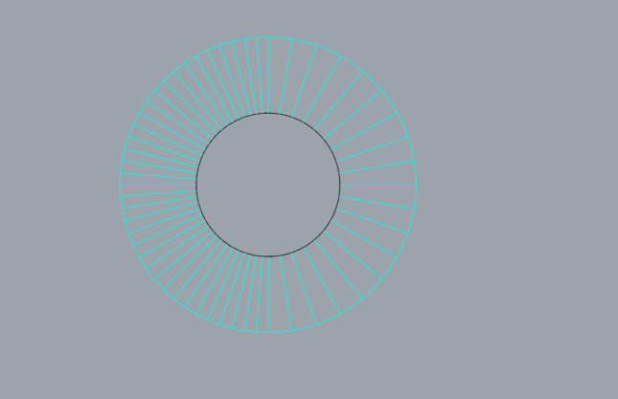
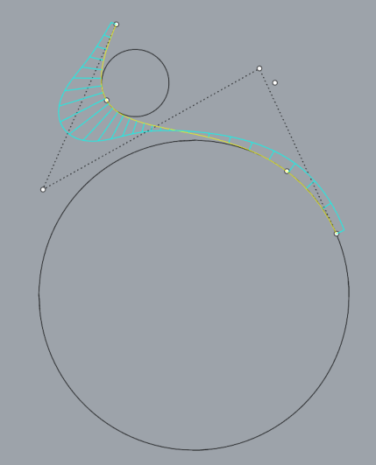
Curvature and Curve Frames
For a circle, this is easy:
curvature = 1/radius
For a line, this is also easy
curvature = 0
What is the radius?
For more general curves, curvature varies continuously at each point, and is 1/the “effective radius” at that point.
See CurvatureGraph
and Curvature

Slide 20
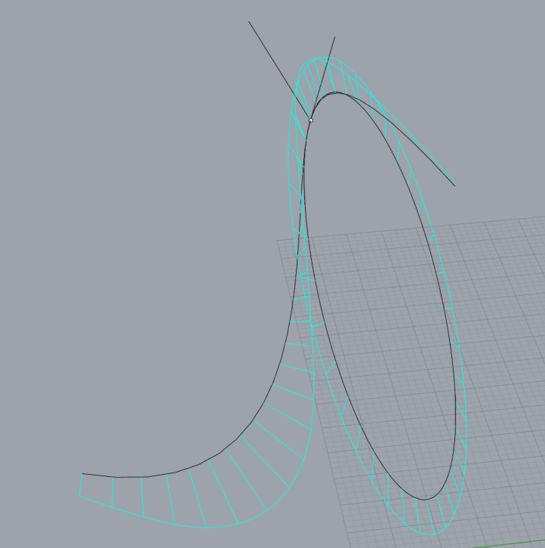
Curve Frames
The local Frame of a curve at a point on the curve is defined by
The tangent vector at the point
The normal to the curve – in the direction of the curvature circle
The binormal of the curve – the vector perpendicular to both the tangent and normal

